Slide 1
New Leader Orientation

Slide 2
The Vision of the BSA
The Boy Scouts of America will prepare every eligible youth in America to become a responsible, participating citizen and leader who is guided by the Scout Oath and Law.
A vision with just a few, but very powerful words:
responsible : we encourage boys to be self sufficient and take responsibility for their duties and actions.
every eligible youth : we do not discriminate, or exclude boys that are different than our own.
participating : we promote self confidence and avoid any discouraging words.
leader : we introduce leadership in Cub Scouts by our example.
New Leader Orientation

Slide 3
The Scout Oath and Law
On my honor I will do my best To do my duty to God and my country and to obey the Scout Law; To help other people at all times; To keep myself physically strong, mentally awake, and morally straight.
A Scout is :
Trustworthy Loyal Helpful Friendly Courteous Kind |  | Obedient Cheerful Thrifty Brave Clean Reverent
Note: Cub Scouts will use the Scout Oath and Law starting in 2015.
New Leader Orientation

Slide 4
What’s the Difference Between Cub Scouts and Boy Scouts?
Age Range
Motto
Leadership
Events
Program
Cub Scouts
6.5 – 10.5
“Do Your Best”
Adult Volunteers
Family Focused
Age appropriate activities that build character
Boy Scouts
10.5 – 17
“Be Prepared”
Youth
Youth Focused
Age appropriate activities that build character
“Cub Scouts are like a minor league baseball team, and Boy Scouts are like the major league. We are getting them ready for ‘the show’.”
New Leader Orientation

Slide 5
The Scouting Organization
Boy Scouts
of America
Orange County Council
Portola District
Creates policy
Creates training materials and publishes all literature.
Advocates vision
Maintains national properties
Mix of professionals and volunteers.
Registration of youth and leaders
Records Achievements
Maintains camps and properties
Coordinates Fundraising
Mix of professionals and volunteers.
Pack 811
Recruits Scouts and Leaders
Fundraises to pay for program
Delivers the Scouting program
All volunteers
Conducts Round- table meetings and training
Runs Day Camp and Camporee
Leader Resources
1 paid professional, all others volunteers.
New Leader Orientation

Slide 6
The Pack 811 Organization
Scout Families
Den Leaders and Assistants
Pack
Leadership
Team
Cubmaster and Assistant
Pack Committee
Pack Committee Chair
Chartered Organization Representative
The Pack Leadership Team meets once a month to plan the agenda and share ideas.
Parents, Chartered Org representatives, and district representatives are welcome at any leadership meeting.
St. Angela Merici Church (Charter Organization)
New Leader Orientation

Slide 7
The Duties of All Leaders
Follow the Scout Oath and Law
Cub Scouts and their parents learn from examples. If you are loyal, your son will be loyal. If you are helpful, other parents will want to be helpful. If you are friendly, we will have a pack of friends.
Represent Pack 811, and the BSA
Once you put on that uniform, people will look to you for answers, or as a sounding board. Always present Scouting in a positive way and encourage other families to join. Learn as much as you can so you can educate others as well.
New Leader Orientation

Slide 8
The Duties of All Leaders
Get Trained!
Learning Never Stops! The following is the minimum training all leaders should take (the first 4 are available on-line):
Youth Protection Training (YPT)
Fast Start Training for your position
This is Scouting
Position Specific Training for your position
BALOO (Basic Adult Leader Outdoor Orientation)
First Aid / CPR Certification
Needed in order to register
Needed in order to wear “trained” patch
Needed in order for the pack or den to go on overnight trips
New Leader Orientation

Slide 9
The Duties of All Leaders
Wear the Leader Uniform with Pride
Again, we teach by example. The Cub Scout Uniform is a method to help build pride, loyalty, and self-respect in boys. This method will not be effective if leaders do not show their pride and self –respect with their uniform.
Be a Leader to All Boys
Parents usually become a leader to make sure their own son has a great experience. This is absolutely commendable. It is our job, however, to make sure all Scouts have a great experience. Just like you would want your son’s teacher to be fair to all students, so must we be sure all Scouts are treated equal.
New Leader Orientation

Slide 10
The Duties of All Leaders
Be a Team Player
All pack leaders are volunteers like you. We need all leaders to share their experience and expertise on all issues, and once a decision has been made, implement the program as one team. Many hands make for light work!
Be an Owner
Don’t let putting on a uniform be the extent of your contribution. Whether you are an Assistant Den Leader or a Committee Member, the success of the pack directly lies on your shoulders. Your ideas and actions are critical to our success. Take charge and own a part of our success!
New Leader Orientation

Slide 11
Leader Positions
Committee Member
Den Leader / Assistant
Works primarily with other leaders behind the scenes to perform all necessary pack functions.
Supports Cubmaster and Den Leaders with program as needed.
May have specific duties in addition to “whatever needed” duties.
Works primarily directly with boys to carry out the program.
As part of pack leadership team, works with other leaders to develop the program.
Helps with “whatever needed” as available.
New Leader Orientation

Slide 12
The Pack Committee
Committee Specific Duties:
Awards Coordinator
Treasurer
Religious Emblem Coordinator
Quartermaster
Fundraising Coordinator
Membership Coordinator
Webmaster
Location Coordinator
Whatever-it-takes
New Leader Orientation

Slide 13
Den Leaders
Den Leader Duties:
Plan the program
Communicate, communicate, and then communicate again
Promote Rank Advancement
Lead Den Meetings and Outings
Represent Den with Pack Committee, and Pack Committee to Den.
Recruit helpers
Recruit new members
Whatever-it-takes
New Leader Orientation

Slide 14
Position Specific Duties
Scouting has been around for more than 100 years, so there is no need to re-invent the wheel. It is always appreciated by scouts and future leaders, however, if you can make the wheel smoother and more fun!
In addition to the on-line training you have taken on line at myscouting.org, our pack has created time-line driven job descriptions for all of our leader positions. These are available on the leader page at cubpack811.org.
There are also plenty of other resources available on line designed to give ideas for den leaders and other pack positions. Several useful sites are listed on our pack website, including usscouts.org and ocscouter.org.
New Leader Orientation

Slide 15
Communication
Just about all leaders will at some point need to communicate to a den or the entire pack. When in doubt, over-communicate! We do this in one of three ways:
A posting on the website which gets sent via email to the pack or a den.
Events listed on our calendar
A direct email to the pack or a den.
An announcement at a pack or den meeting.
By far, the most effective method is the first – a website posting that is also sent via email. This allows for instant email notification, as well as a permanent reference for those who lose track of emails. Reminders and follow-ups would use the other options listed.
New Leader Orientation

Slide 16
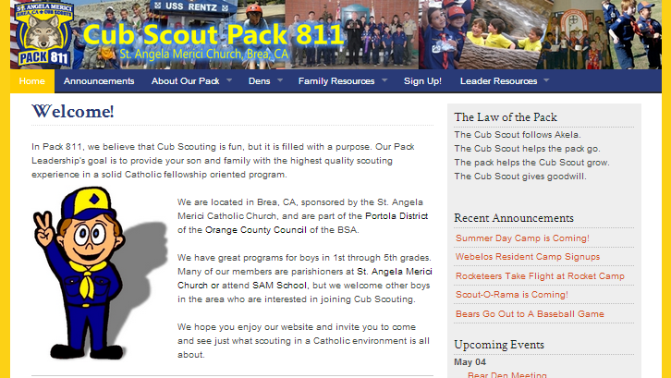
Website Postings
Website postings (announcements) serve several purposes:
A permanent record of pack or den communication.
A record of exciting den activities that others in the pack can learn about and look forward to.
A draw for those looking for a new pack on the web.
Every new posting helps us climb higher in Search Engines and increases the chance new potential Scouts will find us. Some of our past Scouts found us via our website!
New Leader Orientation

Slide 17
Website Postings
How to Create a Web Posting:
Insure that only first name and last initial (no last names) of Scouts are included in the posting.
Pictures can be included, but no 1:1 correlation of a name with someone pictures should be listed. All pictures should be in good taste.
Send an email to website email address:
The subject line will be the title
The body of the email will be the posting
Attached pictures or documents will be included.
To send an email only to a particular den, include [denx] at the beginning of your subject line, replacing ‘x’ with the den number.
New Leader Orientation

Slide 18
E-mails
How to send emails to a group:
Important: Always put these group email addresses in the BCC: field, and your own address in the TO: field. This will eliminate the problem of filling inboxes from those who like to reply to all.
(replace X with den number)
Do not share these group addresses outside of our leadership team; we do not want to introduce spam for our families.
Group | E-Mail Address
Den X Families
Den X Leaders
All Den Leaders
All Pack Leaders
All Pack Families
New Leader Orientation

Slide 19
Calendar
The Pack utilizes multiple Google calendars to maintain the agenda for pack and den events. These calendars populate the various calendars on the website, as well as the calendars on devices that subscribe to them.
Each Den Leader is responsible to maintain their den’s activities on their respective den’s calendar, and the Cubmaster or designated leader is responsible to update the Pack and Leader calendars.
Calendars are maintained at http://google.calendar.com using specific user IDs:
Learn and teach others how to connect to these calendars at http//cubpack811.org/connect
New Leader Orientation

Slide 20
Meeting Room Reservations
Cub Scouts meet, and so a leader must arrange for a suitable meeting place. We typically meet in one of the following:
St. Angela Room or Hall
The Scout House
A Parent’s House
An Outdoor Venue (SAM field or park)
All of these (except a public park) will need a reservation in advance. Your Committee Chair or designee is responsible for all room reservations at both the Church and Scout House. You will usually need a few weeks notice, and availability in not guaranteed, so always have a backup plan in mind!
New Leader Orientation

Slide 21
Money
The pack is responsible to raise all the money needed to put on the program for our boys. This is done through registration fees (about half goes to national and the remainder to the pack) and our fundraisers. As you can see from this graph, about 60% of our budget is obtained through fundraisers. Fundraisers not only make the program affordable for all, but they also teach our boys self sufficiency.
New Leader Orientation

Slide 22
Money
As leaders, we need to not only to participate in fundraisers, but may be asked to assist in their promotion and operation. A few things to keep in mind:
All expenses must be approved in advance from the committee.
The treasurer, and committee, should be made aware of all financial transactions, including den-related transactions.
All expenses are submitted via the Expense report that is available on the pack website. All receipts must be included.
If you are collecting money for an event, then you will submit the money along with a Deposit report – also available on the pack website.
New Leader Orientation

Slide 23
When Do I Wear a Uniform?
 | Pack Leaders | Den Leaders
Pack Meetings | Class A | Class A
Blue & Gold | Class A | Class A
Derbys | Class B | Class B
Pack Nature Outings | Class B | Class B
Den Meetings | none | Class A
Den Nature Outings | none | Class B
Public Ceremonies | Class A | Class A
Roundtable Meetings | Class A | Class A
Pack Leader Meetings | none | none
New Leader Orientation

Slide 24
ScoutTrack
ScoutTrack is an on-line advancement database that we utilize to track advancement and awards for every Scout. It can be found at http://scouttrack.cubpack811.org, or via the link on the Family Menu. Every parent is issued credentials to access the site and view their son’s progress.
Den Leaders or Assistants are responsible for entering all achievements into ScoutTrack. Entries made at least a week prior to a Pack Meeting will be awarded at that month’s meeting. Den Leaders should encourage their families to check ScoutTrack on a monthly basis to keep in touch with their son’s progress.
New Leader Orientation

Slide 25
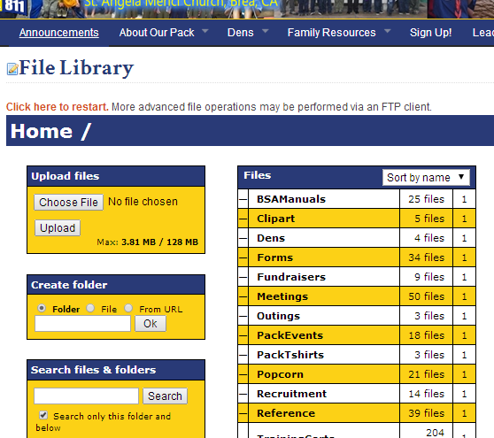
Leader Resources
CubPack811.org
Our Pack Website has a ”hidden” archive that is available only to leaders. When you log in using your leader credential, you will see an additional menu item for leaders called “File Library”. Here you will find event and outing details from previous den and pack leaders. Remember – you don’t have to re-invent the wheel – just keep it fresh!
Fellow Leaders
Other leaders in the pack were once just as “green” as you. Do not be afraid to ask ANY of them for answers or ideas. Our monthly leader meetings are a great time to present questions or problems to the group.
New Leader Orientation

Slide 26
Leader Resources
BSA Publications
The Scout Shop has a host of inexpensive leader books that are full of ideas. Many of these are available on our website as well.
Other Websites
There are many sites on the web full of ideas for Cub leaders. Check the leader page on our website for a partial list. When all else fails, Google knows where to find a bounty of Cub Scout knowledge.
RoundTable
On the second Thursday of the month, all the Cub Scout and Boy Scout leaders in the Portola District meet to exchange ideas. It is always good to attend a few of these every year to get a different perspective on events.
New Leader Orientation

Slide 27
Questions?
Remember: Take Charge!

